Slide 1
California State University, Sacramento Computer Science Department
CSC 131 : Computer Software Engineering
Fall 2021
Lecture # 1
Introduction:
Software Engineering Concepts, Process and Models

Slide 2
What is Software?
A set of instructions that are designed to accomplish a desired task or function.
Software Includes:
Programs
Documents
Data…

Slide 3
Characteristics of Software
A software is engineered or developed.
A software does not wear out, but it deteriorates.
A software is still mostly custom built.

Slide 4
Wear vs. Deterioration
Fig 1

Slide 5
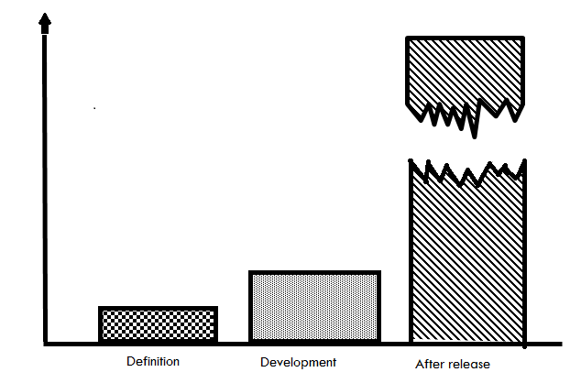
The Cost of Change
Fig 2

Slide 6
Software Applications
System software
Real-time software
Business software
Engineering/scientific software
Embedded software
PC software
AI software
WebApps (Web applications)

Slide 7
Software Engineering Classic Definition (1969)
The establishment and use of sound engineering principles in order to obtain economically software that is reliable and works efficiently on real machines.”
“Software Engineering:
(1) The application of a systematic, disciplines, quantifiable approach to the development, operation, and maintenance of software; that is the application of engineering to software.
(2) The study of approaches as in (1).”

Slide 8
Software Engineering & Problem Solving
COMPUTER
SCIENCE
CUSTOMER
Theories
Computer
Functions
Problem
SOFTWARE
ENGINEERING
Tools and
Techniques to
Solve Problems
Fig 3

Slide 9
Software Engineering Characteristics
Predictable Results
Product will be produced.
Production/release time is known in advance
If results were predictable, we would not see V1.0.1, V 1.0.2, etc. (Are these bug fix releases..?)
Measurable Progress
Product goes through well defined phases
Engineers can reliably measure progress
Metrics can be defined to provide accurate indication of progress and cost.

Slide 10
Characteristics of an Engineering Process
Ability to React/Adapt to Change
The product is well planned and documented
Changes in requirements is well anticipated
Impact of change more readily assessed.
Other Characteristics of an Engineering Process
Well defined and repeatable process
Standardized guidelines and procedures
Documentation

Slide 11
The Process

Slide 12
Software Process
Definition
The activities, techniques, tools, and individuals to produce software/system.

Slide 13
Process Principles
Prescribes all major activities
Uses resources, within a set of constraints, to produce intermediate and final products.
May be composed of sub-processes.
Each activity has entry and exit criteria.
Activities are organized in a sequence.
Has a set of guiding principles to explain goals.
Constraints may apply to activity, resource or product.

Slide 14
Capability Maturity Models CMM & CMMI
Capability Maturity Model (CMM) & Capability Maturity Model Integration (CMMI)
Developed by SEI – (Software Engineering Institute at Carnegie Mellon)
The CMMI project is sponsored by the U.S. Department of Defense (DoD) and the National Defense Industrial Association (NDIA).

Slide 15
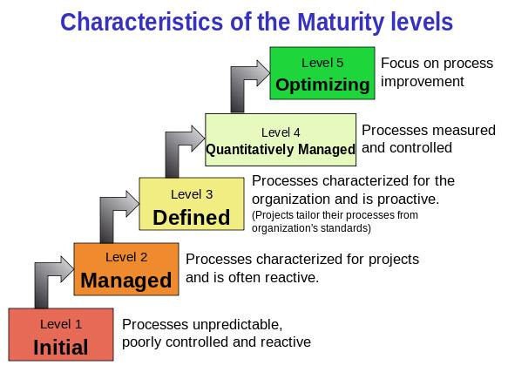
CMM
Fig 5

Slide 16
CMM Five Maturity Levels
Defined
Managed
Optimized
Initial
Repeatable

Slide 17
CMM Five Maturity Levels
Initial level
processes are disorganized, even chaotic. Success is likely to depend on individual efforts, and is not considered to be repeatable, because processes would not be sufficiently defined and documented to allow them to be replicated.
Repeatable level
basic project management techniques are established, and successes could be repeated, because the requisite processes would have been made established, defined, and documented.

Slide 18
CMM Five Maturity Levels
Defined level,
an organization has developed its own standard software process through greater attention to documentation, standardization, and integration.
Managed level,
an organization monitors and controls its own processes through data collection and analysis.
Optimizing level,
processes are constantly being improved through monitoring feedback from current processes and introducing innovative processes to better serve the organization's particular needs.

Slide 19
CMMI Maturity Levels
Optimizing
5
Focus on process improvement
Quantitatively
Managed
4
Process measured and controlled
Process characterized for the organization and is proactive
Defined
3
Managed
2
Process characterized for projects and is often reactive
Performed
1
Process unpredictable, poorly controlled and
reactive
Fig 6

Slide 20
Software Process Models
Strategy need to be developed to solve an actual problem.
This strategy encompasses: Process, Methods, and tools.
This strategy is known as a Process Model
The process model is chosen based on the following:
Nature of the project
Methods and tools to be used
Deliverables that are required

Slide 21
Process as Problem Solving
Software development can be characterized as a problem-solving process
Fig 7

Slide 22
Variations in the Process
Regardless of exact procedure, all broadly follow the phases of SW Life Cycle
Requirements phase
Specification phase
Design phase
Implementation phase
Testing phase
Maintenance phase
Some use different terms – some combine phases

Slide 23
Software Life-Cycle Models
Definition
The series of steps through which the product progresses
The model specifies
The various phases of the process
e.g., requirements, specification, design…
The order in which they are carried out

Slide 24
Software Lifecycle Models
Build-and-fix
Develop systems
Without specs or design
Modify until customer is satisfied
Why doesn’t build-and-fix scale?
Changes during maintenance
Most expensive!

Slide 25
Software Lifecycle Models
Waterfall model : Also known as Linear Sequential Model
Requirements
Phase
Requirements
Description
Specification
Phase
Specification
Design
Phase
Design Docs
Implementation
& Integration
Phase
Product
Fig 8

Slide 26
Drawbacks of Waterfall Model
Document-driven model
Customers cannot understand them …
Imagine an architect just showing you a textual spec!
First time client sees a working product is after it has been coded. Problems here?
Leads to products that don’t meet customers needs

Slide 27
Drawbacks of Waterfall Model
Assumes feasibility before implementation
Re-design is problematic
Works best when you know what you’re doing
When requirements are stable & problem is well-known

Slide 28
V Model
In software development, the V-model represents a development process that may be considered an extension of the waterfall model.
Instead of moving down in a linear way, the process steps are bent upwards after the coding phase, to form the typical V shape.

Slide 29
V Model
The V-Model demonstrates the relationships between each phase of the development life cycle and its associated phase of testing.
The horizontal and vertical axes represents time or project completeness (left-to-right) and level of abstraction (coarsest-grain abstraction uppermost), respectively.

Slide 30
Agile Model
Manifesto
Individuals and interactions over processes and tools
Working software over comprehensive documentation
Customer collaboration over contract negotiation
Responding to change over following a plan
Notes:
References:
https://agilemanifesto.org/
Agile Estimating and Planning, Book by Mike Cohn
https://www.tutorialspoint.com/sdlc/sdlc_agile_model.htm

Slide 31
Agile Model : Principles
Satisfy customer through continuous delivery of valuable software.
Welcome changing requirements, even late in development.
Deliver working software frequently short sprints
Business and IT work together.
Trust and accountability
Close and frequent communication - face–to–face conversation.
Notes:
References:
https://agilemanifesto.org/
Agile Estimating and Planning, Book by Mike Cohn
https://www.tutorialspoint.com/sdlc/sdlc_agile_model.htm

Slide 32
Agile Model : Principles
Working software is the primary measure of progress
Agile processes promote sustainable development
Technical excellence and good design enhances agility
Simplicity
Self–organizing teams and self- cross functional teams
self reelections through retro
Notes:
References:
https://agilemanifesto.org/
Agile Estimating and Planning, Book by Mike Cohn
https://www.tutorialspoint.com/sdlc/sdlc_agile_model.htm

Slide 33
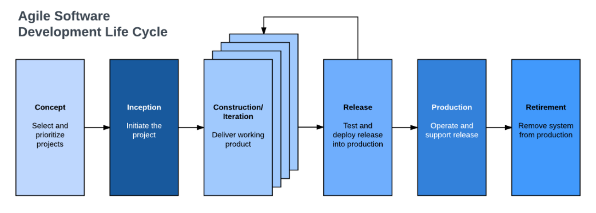
Agile Model
By breaking the product into cycles, the Agile model produces ongoing releases, each with small, incremental changes from the previous release based on the customer feedback.
Notes:
References:
Software Engineering A Practitioner’s Approach , Book by Roger S. Pressman
https://www.tutorialspoint.com/sdlc/sdlc_agile_model.htm

Slide 34
Agile Model : Scrum
Scrum - distinguishing features
Development work is partitioned into “packets”
Testing and documentation are on-going as the product is constructed
Work occurs in “sprints” and is derived from a “backlog”
Changes are not introduced in sprints but in backlog
Meetings are very short (15 minutes daily)
Notes:
References:
Software Engineering A Practitioner’s Approach , Book by Roger S. Pressman

Slide 35
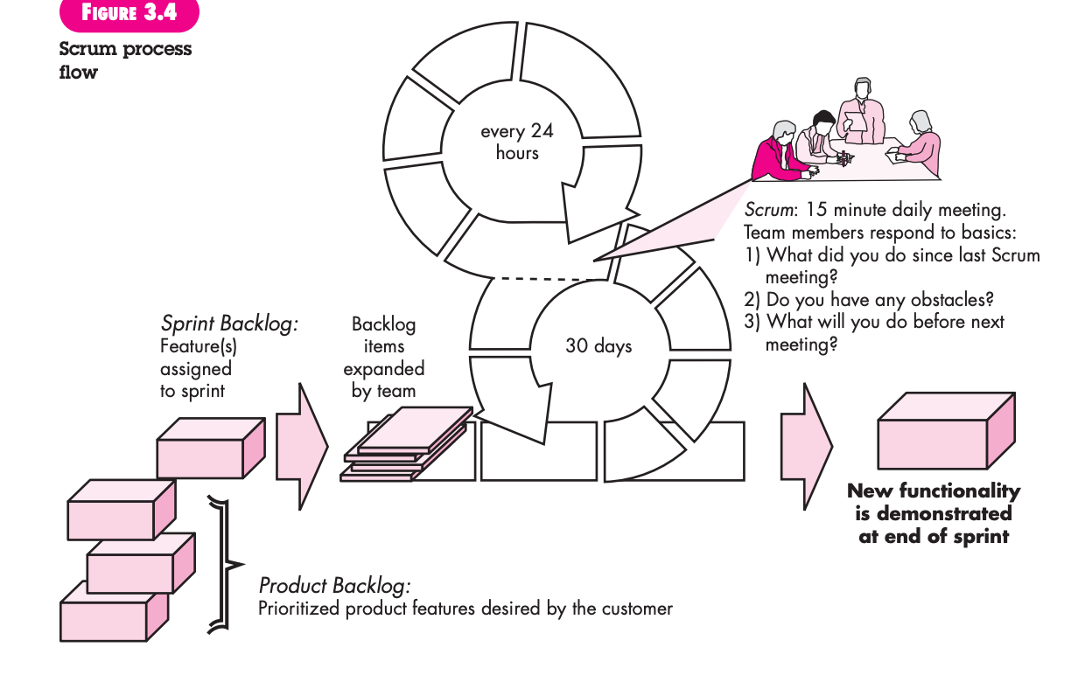
Agile Model : Scrum
Notes:
References:
Software Engineering A Practitioner’s Approach , Book by Roger S. Pressman

Slide 36
Software Lifecycle Models
What are some other Software Lifecycle Models?
Read about other Software Lifecycle Models?

Slide 37
The Primary Goal: High Quality Software
Critical Quality Attributes
Reliability
Maintainability
Dependability
Efficiency
Usability
Other Attributes
Completeness
Compatibility
Portability
Scalability
Robustness
Testability
Reusability……

Slide 38
The Primary Goal: High Quality Software
Other Attributes
Completeness
Compatibility
Portability
Scalability
Robustness
Testability
Reusability……

Slide 39
Questions…?
What is next..?
Software Engineering Project Discussion
Next Topic:
System Engineering & Requirements Engineering

